Slide 1
Up grad Assignment- Lending Club Case Study
Group Facilitator: Mohak Purushottam Pingle
Other group member : Pooja U

Slide 2
Problem statement
A consumer finance company which carries out various types of lending activities in urban customers. There are various risks associated with lending activities, and in order to secure the company's business as well as to find prospectus customers a quite diligent analysis is to be undergone with the data's available from past loan approvals which may have been defaulted and non-defaulted.
A data analysis on what a consumer finance company should look forward in the application of advances to reduce the chances of defaulters.

Slide 3
Analysis overview
The data provided consist of entries of 39717 loan issued in the time period 2007 to 2011 by a consumer finance company
Initial analysis on all the null values have been carried out and removing the irrelevant datapoints from the dataset is done.
Analysis on different parameters that are given in the data set is analyzed to find out the relevant parameters that can be used to identify the defaulter risk.
Removal of unwanted columns as a part of data cleaning is done to make the dataset more perceivable for different analysis.

Slide 4
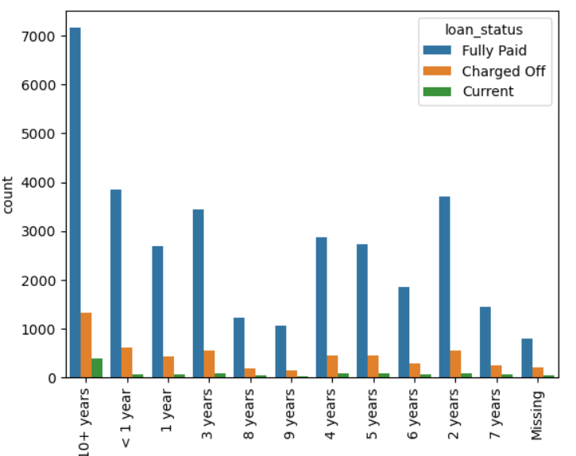
Employment length of the customer and the loan status
With regard to the charged off, increase in tenure of employment the proportion of charged off reduces.
Also it is observed that for employment period greater than 10 years there is more fully paid loan as well as there is a more charged off.

Slide 5
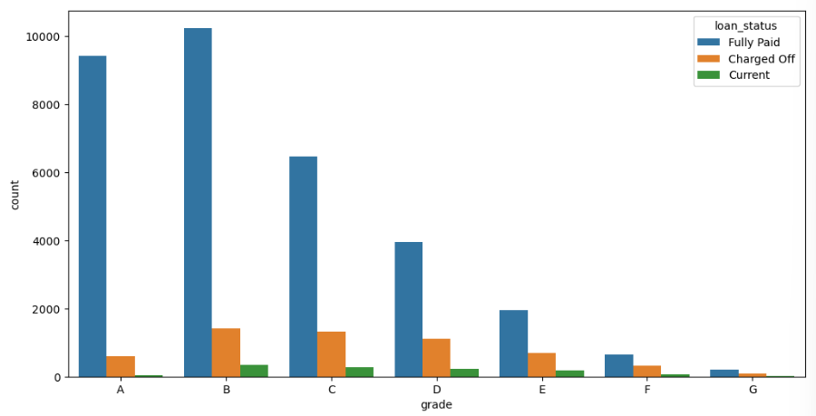
Grade of the customer and the loan status
It is observed that the customers who have been graded B,C,D are more of a defaulters when compared to other graded people.
With respect to grades ,customers who are graded F and G are least risk prone customers for loan defaulters.

Slide 6
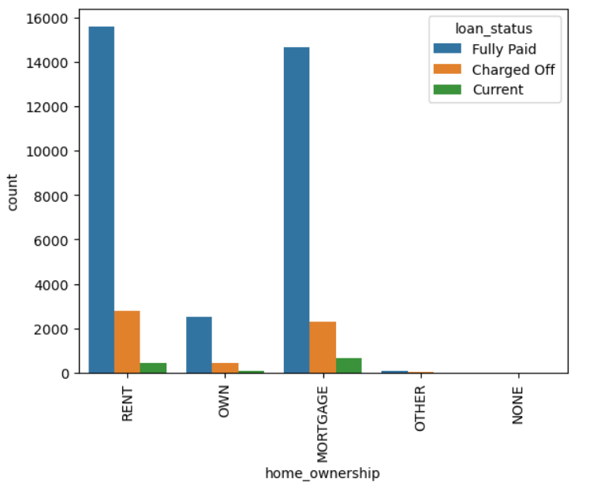
Home Ownership of customer and the loan status
It is observed that customers who have own house has least risk of defaulting.

Slide 7
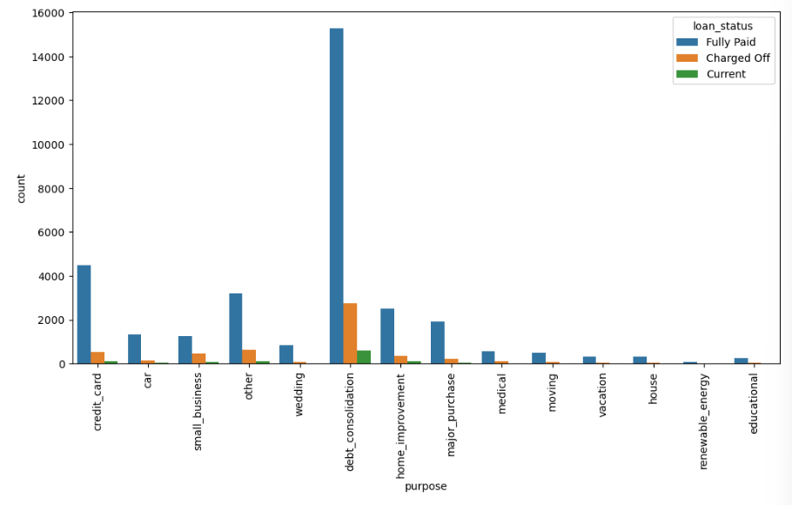
Purpose and the loan status
It is observed that more charged off takes place to loan taken for the purpose of debt consolidation.
It is always better not to provide loans for debt consolidation with a higher rate of interest in order to reduce the risk.

Slide 8
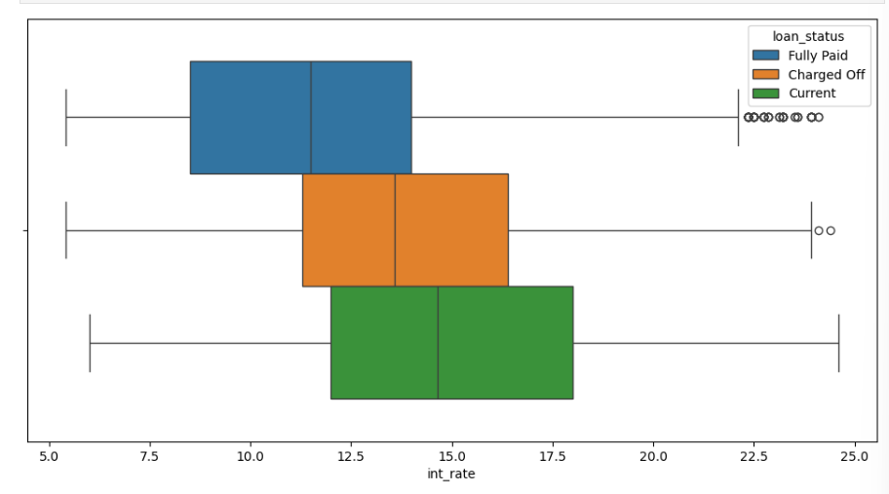
Comparison of Interest rate on all loan status
It is observed that for the charged off loan the rate of interest is more on comparison to the fully paid loan.

Slide 9
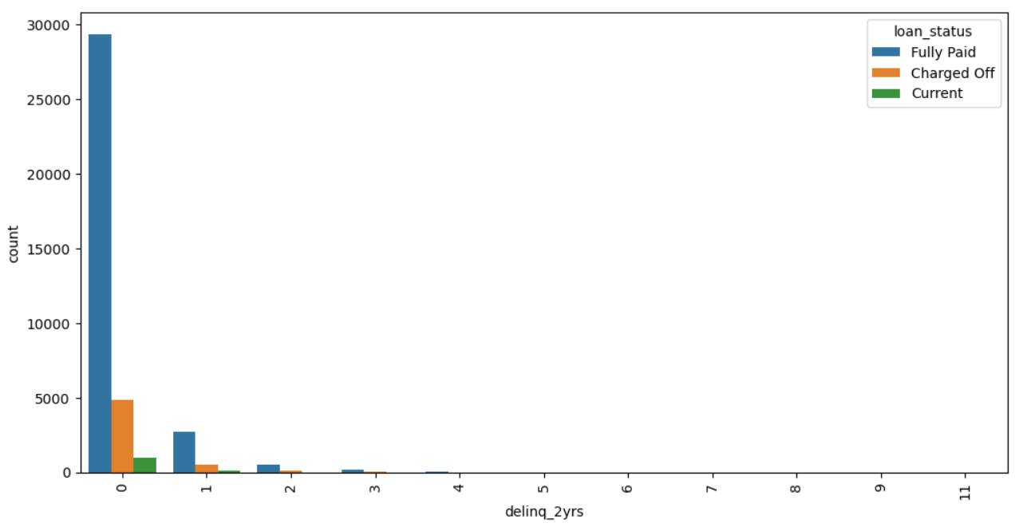
The dependance of the delinquency in borrowers credit file for the past 2 years with respect to the loan status
The more the delinquency and borrowers credit file the less defaulting is observed.

Slide 10
Conclusion

